Slide 1
A Good Soldier Or Random Exposure?
A Stochastic, Accumulating Mechanism To Explain Frequent Citizenship
Dissertation Defense
Christopher R. Dishop

Slide 2
Random Requests

Slide 3
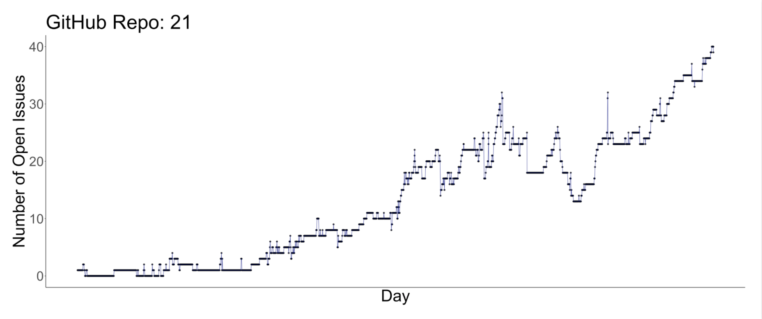
Random Requests

Slide 4
Random Requests

Slide 5
Random Requests

Slide 6



Random Requests

Slide 7
Social Capital & Sustained Lead

Slide 8
Situation x Person

Slide 9
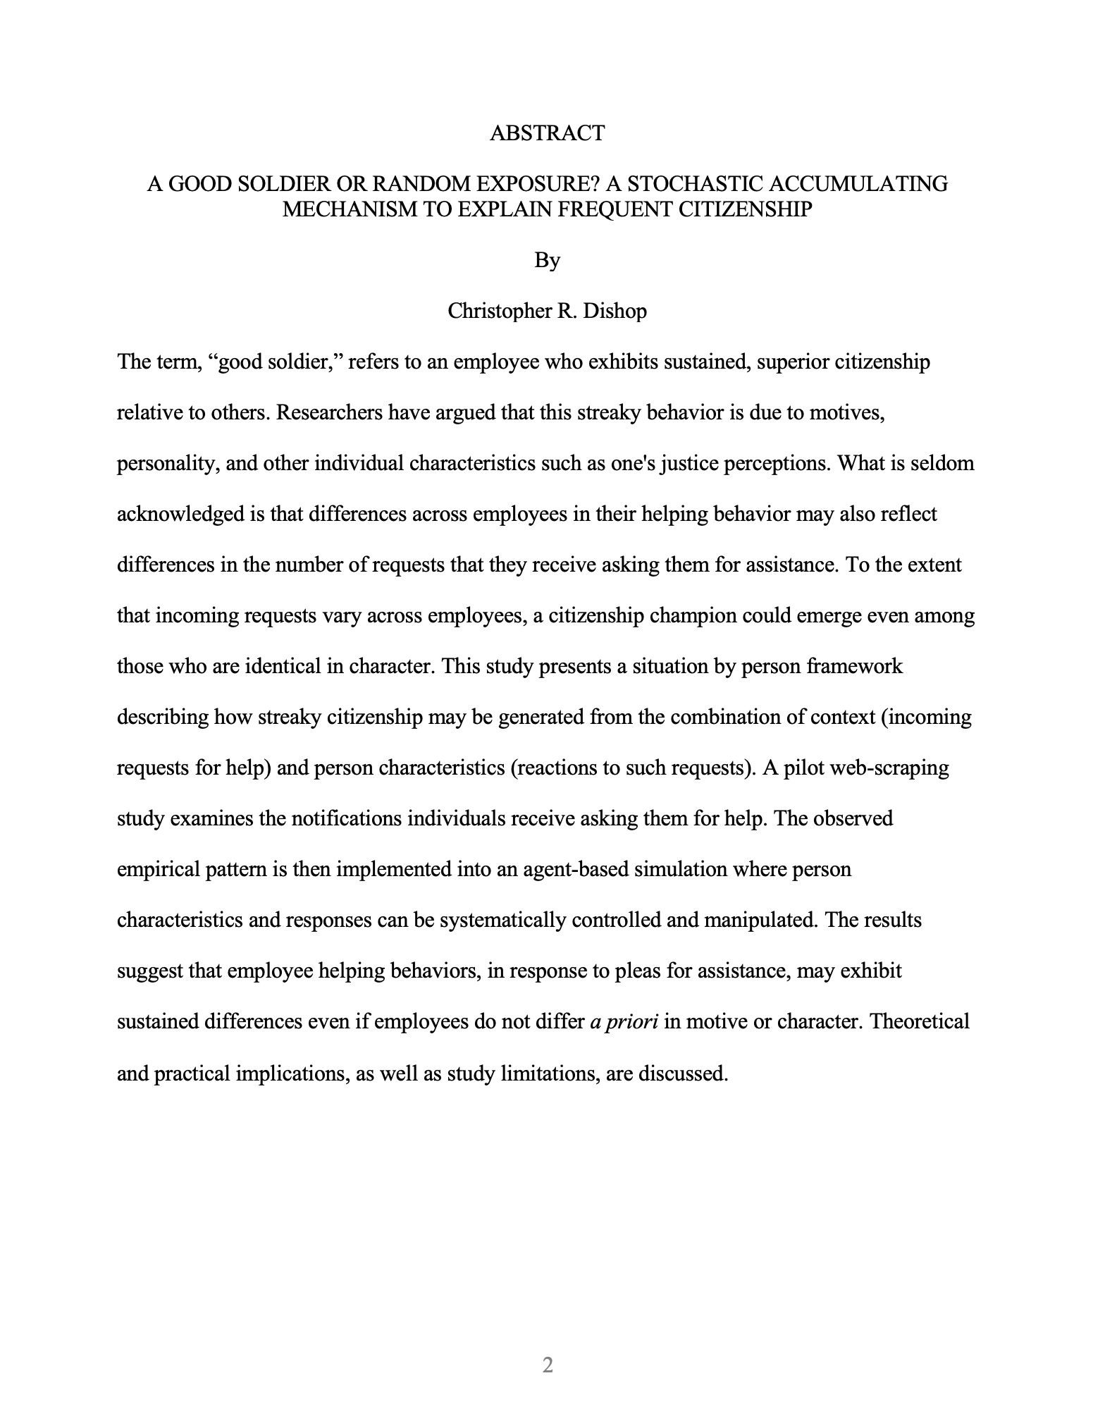
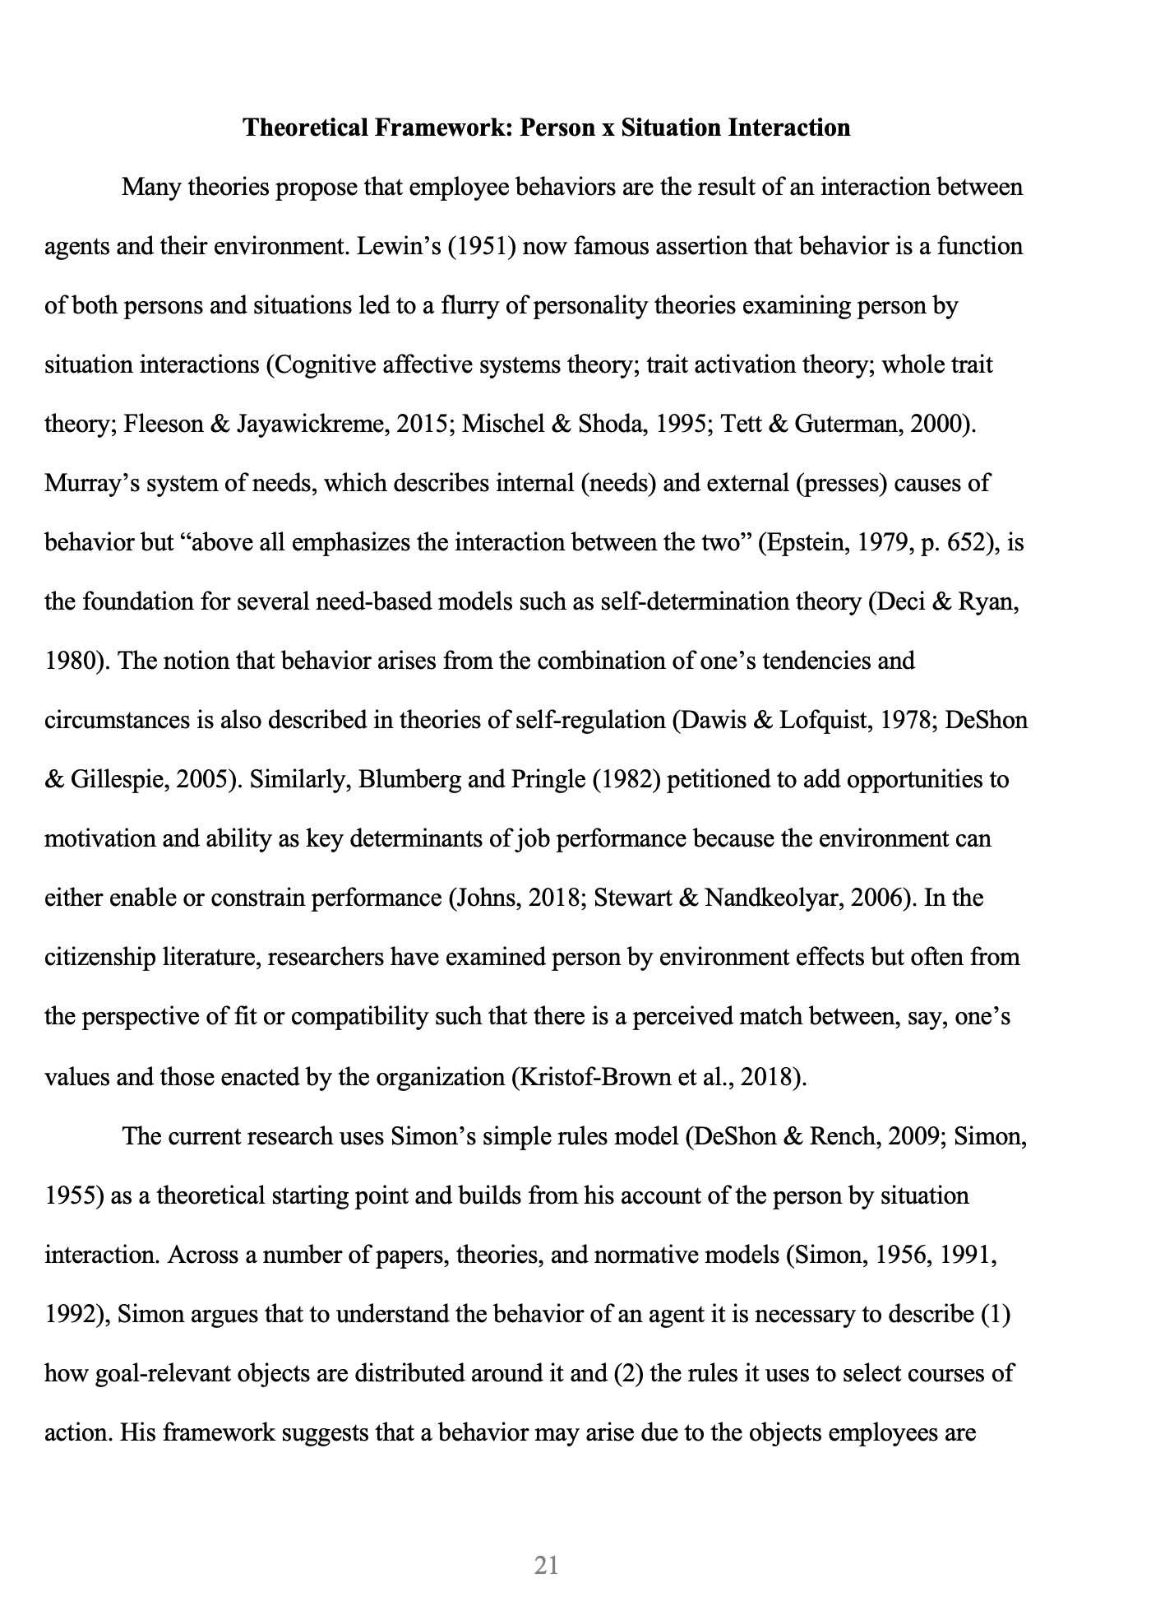
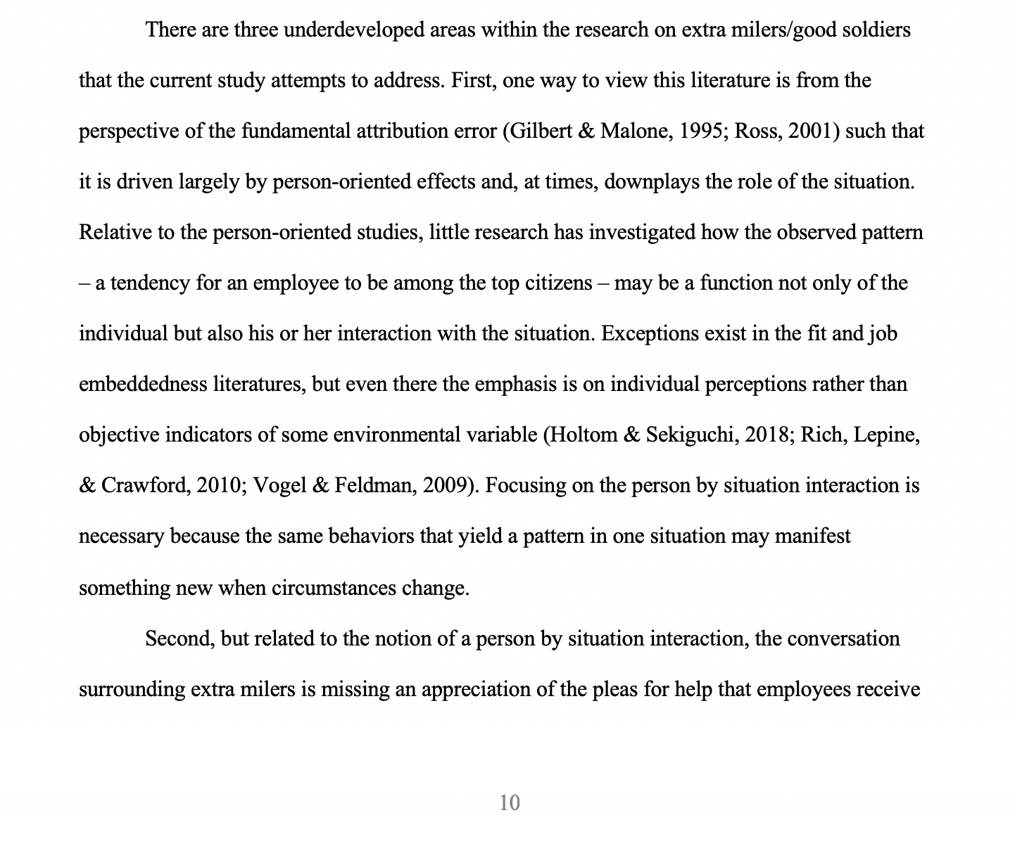
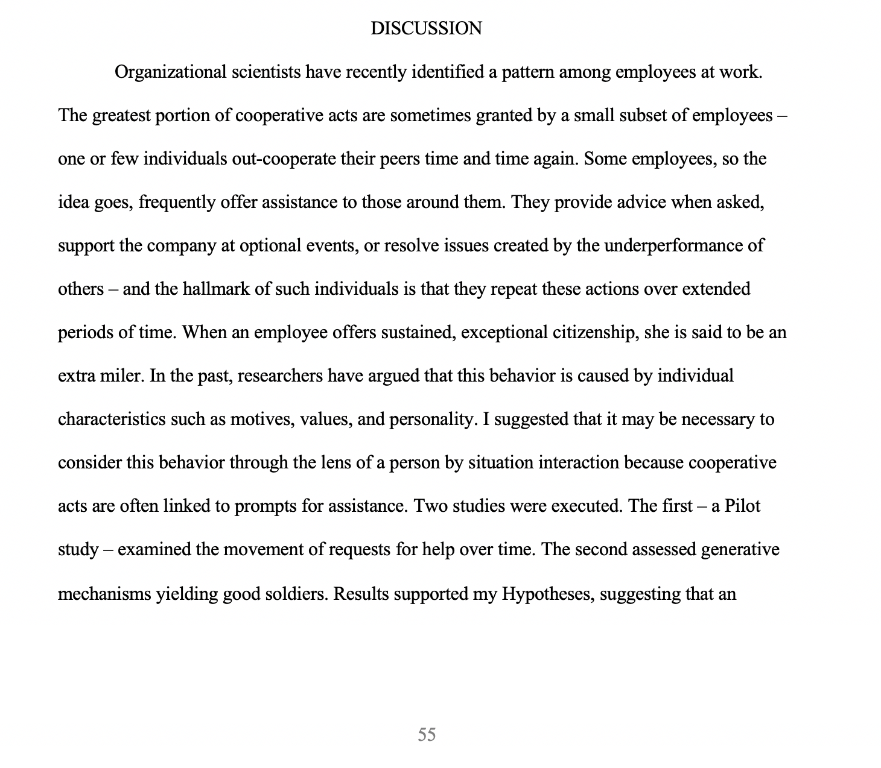
Situation x Person
Abstract
3rd Paragraph Intro
Theory
Discussion

Slide 10
Wording & Framing

Slide 11
Wording & Framing
Manager Perceptions

Slide 12
Wording & Framing
Manager Perceptions
Opportunities

Slide 13
Person - Responses to Notifications

Slide 14
Person - Responses to Notifications
Respond to many
Respond to few
Respond to influx
Respond to outflow
Norm conformity

